Slide 1
Columbia Asia Hospital Analysis
DHRUV KR. KESHRI

Slide 2

ABOUT : COLUMBIA ASIA HOSPITAL
Columbia Asia Hospitals is a renowned healthcare institution known for its patient-centered approach and medical excellence. It operates across multiple countries, offering high-quality healthcare services with modern infrastructure and advanced technology. The hospital’s skilled and compassionate professionals provide personalized care, aiming to improve health outcomes and promote a healthier society.

Slide 3
AGENDA
Problem Statement
Data Description
Objective Key Metrics and Visualizations
Subjective Question for Insights
Reporting

Slide 4
PROBLEM STATEMENT
As a consultant data analyst for Columbia Asia Hospitals, you are assigned to evaluate the hospital’s operational and financial performance.
The hospital aims to achieve the following objectives:
Evaluate the hospital’s revenue performance
Identify departments that require additional hiring
Recommend effective patient discount strategies
Based on your analysis, prepare a comprehensive report that provides actionable insights to support decision-making and improve overall efficiency and patient satisfaction.

Slide 5
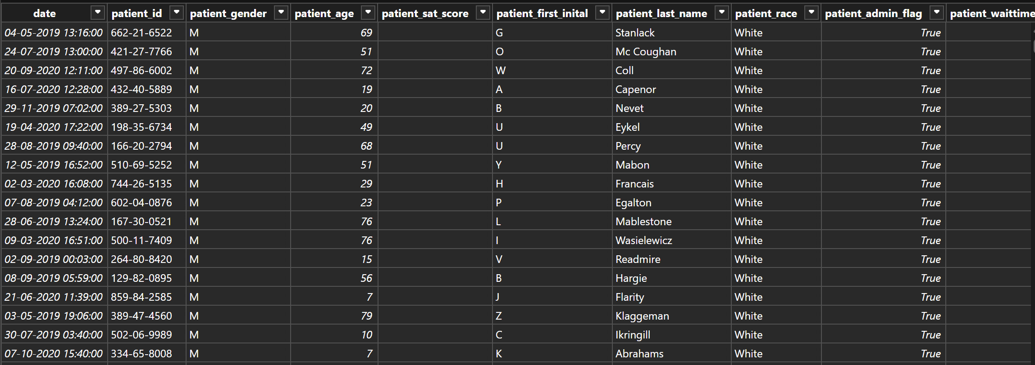
DATA OVERVIEW
Dataset 1: Hospital ER
Contains 9,216 patient records
Includes date, patient ID, age, gender, and race
Tracks patient wait time and admission status
Captures patient satisfaction scores
Helps analyze ER operations and patient flow

Slide 6
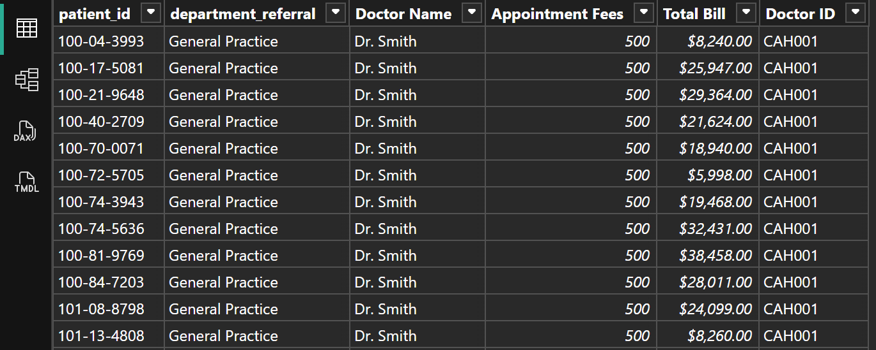
DATA OVERVIEW
Dataset 2: Doctor Patients Data
Includes doctor names and department referrals
Tracks appointment fees and total billing
Contains doctor ID and patient visit details
Useful for analyzing revenue and doctor performance
Overall Insights
Combines operational + financial data
Enables revenue, staffing, and efficiency analysis
Supports better decision-making and patient experience improvement

Slide 7
METHODOLOGY
Data Cleaning & Transformation
Used Power Query Editor to clean and transform data
Handled missing values and inconsistencies
Ensured data accuracy and integrity
Data Processing
Applied sorting, filtering, and merging techniques
Structured data for efficient analysis
DAX Implementation
Used DAX functions like SUM, AVERAGE, IF, CALCULATE
Created measures for revenue, wait time, and performance
Data Visualization
Developed interactive dashboards in Power BI
Used charts, tables, and reports for clear insights
Insight Generation
Analyzed patient demographics and trends
Evaluated department performance and waiting time
Supported data-driven decision-making

Slide 8
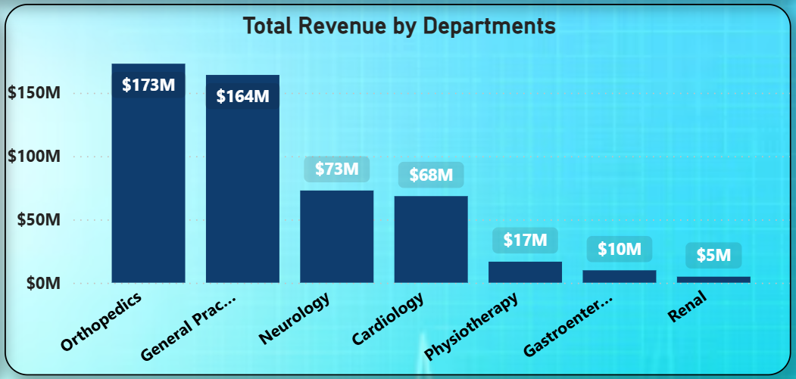
TOTAL REVENUE BY DEPARTMENTS
This visualization shows revenue contribution by each hospital department.
Orthopedics ($173M) and General Practice ($164M) are top revenue-generating departments.
Neurology ($73M) and Cardiology ($68M) show moderate revenue contribution.
Physiotherapy ($17M), Gastroenterology ($10M), and Renal ($5M) contribute minimal revenue.
Revenue is concentrated in top 2 departments, showing dependency.
There is opportunity to grow revenue in lower-performing departments.

Slide 9
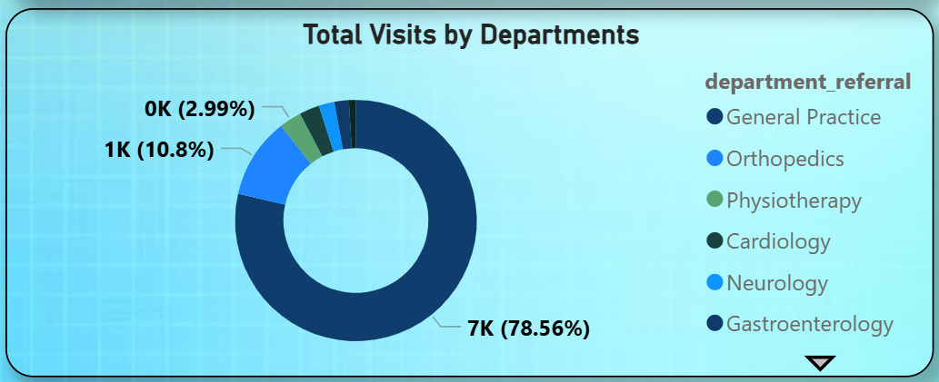
TOTAL VISITS BY DEPARTMENTS
This visualization highlights patient visit distribution by department
General Practice dominates with 78.5% of total visits.
Orthopedics contributes moderately with 10.8% of visits.
Physiotherapy, Cardiology, Neurology show low visit volumes.
Gastroenterology has minimal share among all departments.
Visits are highly concentrated in one department.
There is scope to balance patient load better.

Slide 10
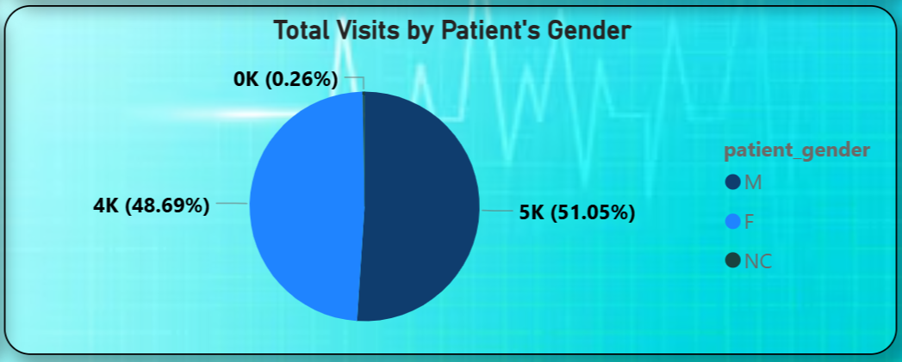
TOTAL VISITS BY PATIENT GENDER
The visualization presents how patient visits are distributed across different genders
Male patients account for 51.05% (5K visits), slightly leading overall visits.
Female patients represent 48.69% (4K visits), showing a very close distribution.
Non-classified (NC) accounts for 0.26% (0K visits), contributing minimally.
The difference between male and female visits is very small (2.36%).
Overall, patient visits show a balanced gender distribution across the hospital.

Slide 11
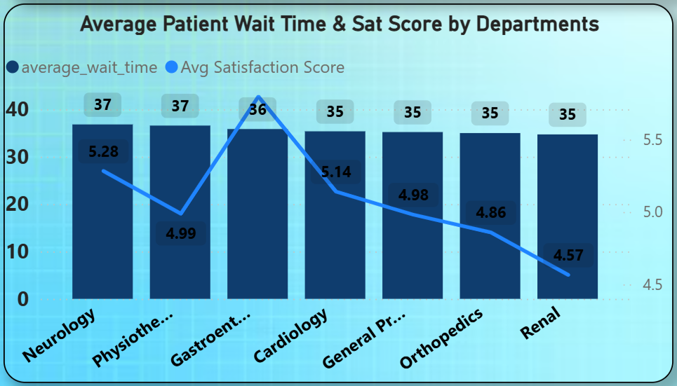
AVERAGE PATIENT WAIT TIME & SAT. SCORE BY DEPARTMENT
The chart presents the comparison of avg. patient wait time and sat. scores across dept.
Neurology & Physiotherapy have highest wait time (37 mins) with moderate satisfaction.
Gastroenterology has slightly lower wait time but highest satisfaction.
Cardiology & General Practice show stable wait times with average satisfaction.
Orthopedics & Renal have similar wait times but lowest satisfaction.
Satisfaction decreases across departments despite similar wait times.
Indicates other factors affect patient satisfaction beyond wait time

Slide 12
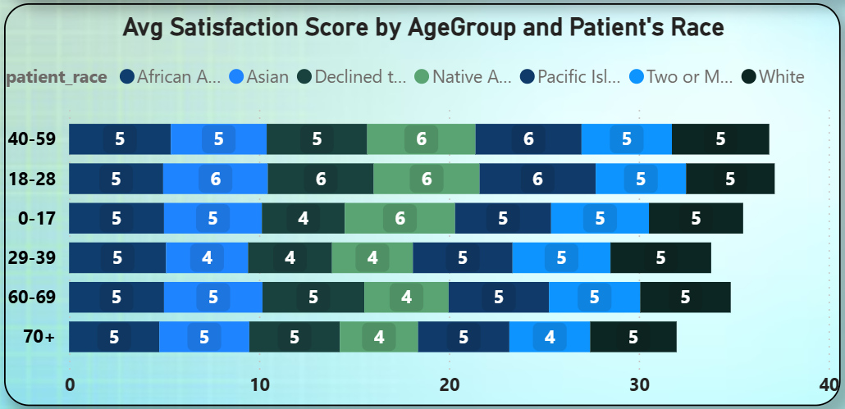
PATIENT SATISFACTION ANALYSIS BY AGE & RACE
The chart presents average patient satisfaction scores across age groups and races
Satisfaction scores are consistent (4–6) across age groups and races.
Age group 18–28 and 40–59 show higher satisfaction levels.
Age group 29–39 shows relatively lower satisfaction scores.
Older groups (60+) maintain stable satisfaction levels.
Variation across races is minimal, showing balanced experience.
Overall, satisfaction is uniform across demographics.

Slide 13
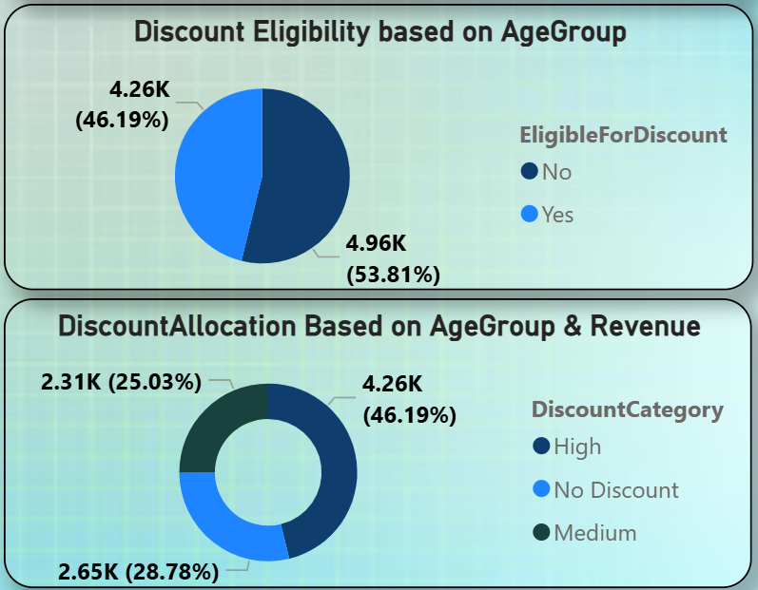
DISCOUNT STRATEGY
The charts present discount eligibility and allocation across age groups and revenue categories
53.81% (4.96K) patients are not eligible, while 46.19% (4.26K) receive discounts.
Most patients do not receive discounts, showing limited coverage.
High discounts dominate (46.19%), followed by No Discount (28.78%) and Medium (25.03%).
Discount distribution is selective, focusing on specific groups.
Strategy should focus on targeted discounts for high-value patients.

Slide 14
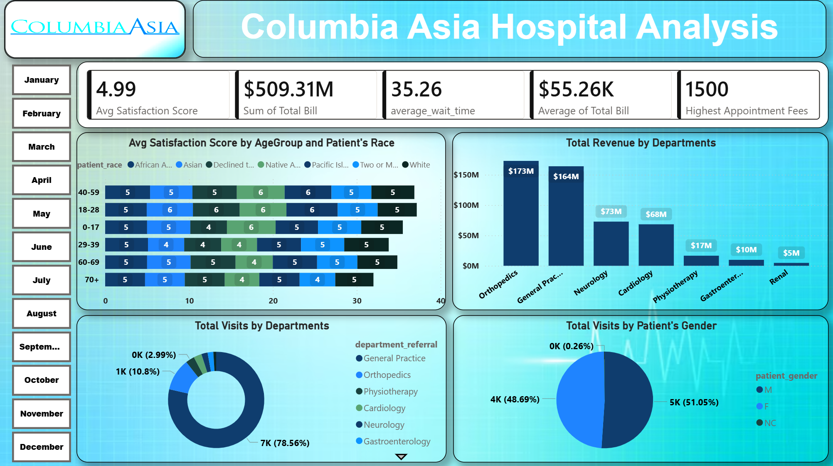
DASHBOARD(Main Tab)

Slide 15
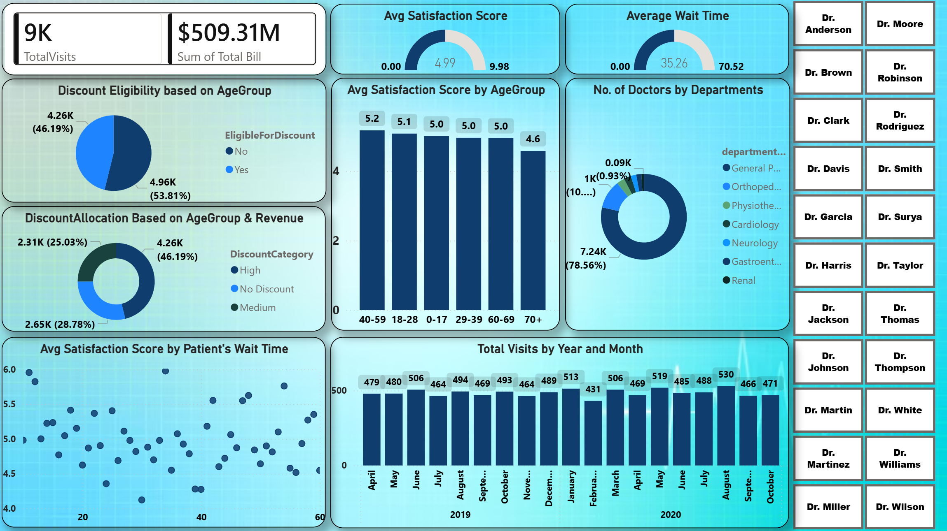
DASHBOARD(Doctor’s Tab)

Slide 16
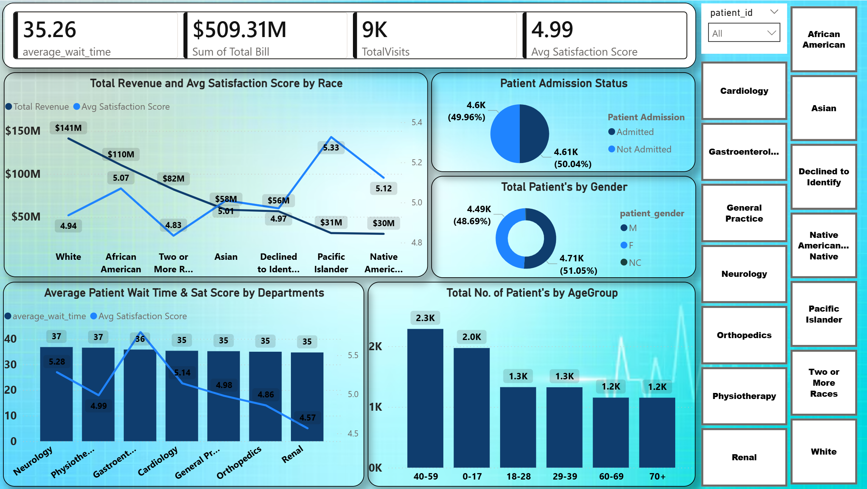
DASHBOARD(Patient’s Tab)

Slide 17
RECOMMENDATION
Optimize staffing in high-traffic departments: General Practice handles 7K+ visits (78.5%), requiring better staff allocation and patient flow management.
Strengthen top revenue departments: Orthopedics ($173M, 33.96%) and General Practice ($164M, 32.21%) contribute 66%+ of total revenue.
Improve patient experience beyond wait time: Wait times are similar (35–37 mins), but satisfaction varies (4.57–5.6), indicating service gaps.
Implement targeted discount strategies: Only 46.19% (4.26K) receive discounts; focus on high-value patients instead of broad distribution.
Enhance data quality for better insights: Address missing and inconsistent data to improve future analysis.

Slide 18
CONCLUSION
Columbia Asia Hospital shows strong performance in revenue and patient volume, with Orthopedics ($173M) and General Practice ($164M) leading.
There is a need to optimize staffing and workload, as General Practice handles 78.5% of total visits.
While wait times are consistent (35–37 mins), variations in satisfaction (4.57–5.6) highlight need to improve service quality and experience.
The discount strategy is selective, but can improve by targeting high-value patients using visit frequency and billing.
Improving data quality and completeness will support better insights and decision-making.

